Slide 1


SAP UI5 & FIORI with OData TRAINING
Anubhav Oberoy
Day – 6

Slide 2

Agenda – Day 6
Understanding how UI5 works
Views in UI5
Introduction to XML
Concept of controller in UI5
Control Hierarchy
Hook Methods of the controller
Concept of Model in UI5
Understanding Important point related to models
Steps to create model
Addressing model in views
Concept of binding in UI5
Expression Binding
Binding Modes
Aggregation Binding
Element Binding

Slide 3
How UI5 Framework works
Browser
CDN
1
View
getControllerName
Retern CONTROLLER
createContent
return CONTROLLER_OBJ
Index.html
SAP UI5 Framework
2
var oView = new sap.ui.view({
viewName: “mickey.view.Main",
type: "JS“
});
6
C
5
Renderer
Controller
onInit()
C
HTML + CSS
3
4

Slide 4
Views in SAP UI5
View is responsible to manage information display to the users.
Views are based on Model.
There are Four types of views in SAP UI5, these are listed below:
XML View:- It is in the XML format. The file name ends with the extension “.view.xml”. There are no predefined methods in the XML view.
JS View:- It is in JavaScript format. The extension of the view file is “.view.js”.
JSON View:- It is in JSON format. The file name ends with the extension “.view.json”.
HTML View:- It is in HTML format. The file name ends with the extension “.view.html”. Here we create the controls within the <div> tags, as we do while developing HTML pages.
Percentage Usage of Views:
2%
99%
JOSN View – 0%
HTML view – 0%
JS View is used only in 2% of the views.
XML Views are the mostly used views now a days.
The use of JSON and HTML views are negligible

Slide 5
XML View
What is XML?
XML stands for eXtensible Markup Language, it was originally developed to move data from one to another technology. It became popular to communicate between heterogeneous technologies.
XML is a tree data structure. Unlike HTML, we can use custom tags. Every programming language must support XML.
Portal
Java
App
ABAP
If_ixml
xml
xml
Data Objects → XML – Rendering
XML → Data Object - Parsing

Slide 6
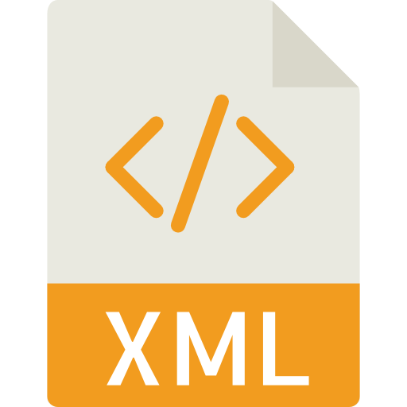
Structure of XML
<data>
<empStr>
<empId>5000</empId>
<empName>Jack</empName>
<salary>9500</salary>
<currency>EUR</currency>
</empStr>
<empTab>
<row>
….
</row>
</empTab>
</data>
Root Element
Child Element of <data> tag
Child Element of <empStr> tag
Skeleton of XML View
<core:View xmlns:core=“sap.ui.core” xmlns=“sap.m” controllerName=“pathOfContro.”>
<Button text=“Click Me”></Button>
</core:View>

Slide 7
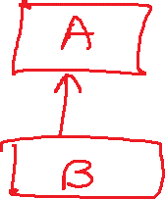
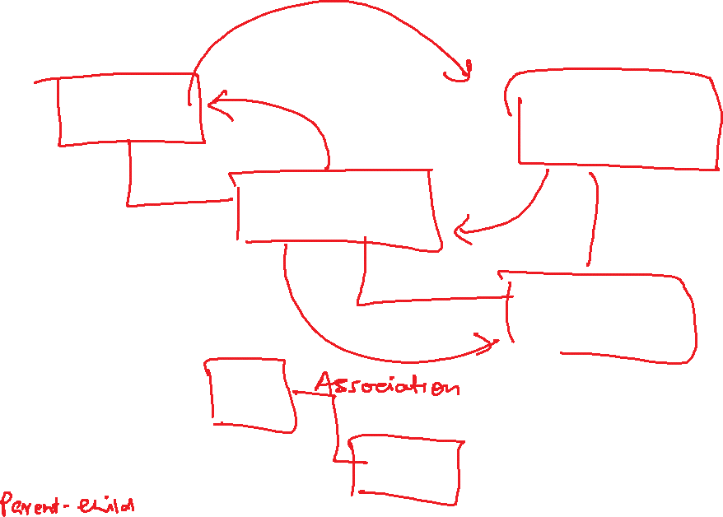



Slide 8
Controller in UI5
A controller contains methods that defines how models and views interact.
You define a simple controller as follows:
sap.ui.define([ "sap/ui/core/mvc/Controller" ],
function(Controller) {
"use strict";
return Controller.extend(“Address of Controller", {
// controller logic goes here
});
});
Special Class which inherits from standard SAP module called sap/ui/core/mvc/Controller
Skeleton of any JS file in SAP UI5 – Considered as a class
sap.ui.define([“dependencies”, “dep2”, “dep3”],
function(oD1, oD2, oD3) {
--logic—
}
);
Modules

Slide 9
Basics of Controller
For every Control if there is a property, we will have setter and getter methods for that property. For example, if there is a enabled property, we will have setEnabled and getEnabled methods.
To access the methods and properties of a UI Control, We cannot use the document object which is a plain HTML element object.
To obtain UI5 element object, we need to first get View Object,
this.getView()
On top of App object, we can get UI5 element object and finally
byId(“just pass ID”)
we can call any methods of UI5
For every event in UI5, we have attachEvent, detachEvent, fireEvent methods as well, which can be used to link, delink and trigger event programmatically.
When we use JS view, inside the event handler, this pointer will point to the current control object not the class (controller) object. In order to force this pointer to work like our Controller object, we need to pass it explicitly. This ONLY applies in JS View.
Just now you showed getting view object from controller, this.getView(), Using this view object also can I get my control objects? Just to avoid sap.ui.getCore() – You can but in XML View
When we use XML views, the ID of the control will be viewId--controlId

Slide 10

Basic of OOPS
A relation between 2 classes which are not of same family is called association
Aggregation – lose coupling, both objects can function independently, should have relationship
Composition – tight coupling, both objects must CO-exist, must have relationship, they cannot function independently
Passenger
+passportno, +name, +nationality +isfamily
Drive(), check-in(), securitycheck()
0..*
Airplane
+height +width +color
Fly(), land(), load()
Airplane
+height +width +color
Fly(), land(), load()
Wings
+height +company +size
Rudder() alerons()
1..*
Passenger plane
+No_of_seats
Bording()
Cargo plane
+Cargo_space
Loading()
Passenger plane
+No_of_seats
Bording()

Slide 11
Control Hierarchy
sap.ui.base.ManagedObject
Syntax to create object
var oName = new libraryName.ControlName({
prop: Val,…
});
Note:- Whenever we see a control, and if we are unable to find a property, association, event or function in that class, check its parent class.
sap.ui.core.Element
sap.ui.core.Control
sap.m.Button
sap.m.InputBase
sap.ui.view
sap.m.Table
sap.ui.layout.form
sap.m.Input
SimpleForm
sap.m.Column
Some of the Frequently used controls in SAP

Slide 12
Hook Method of Controller
onInit()
onBeforeRendering()
It is a function which gets called immediately after UI5 creates the object of our controller. It is like constructure of a class. We can use this to initialize our class variable
It is a method which gets called MULTIPLE times, Before every time the view is displayed to the user. We can use this method for pre-processing on a view.
IN
BR
EX
AR
onExit()
onAfterRendering()
It is a function which gets called before the instance of our controller gets destroyed. It is like destructor of a class.
We can use this to write clean-up code.
It is a method which gets called MULTIPLE times, After every time the view is displayed to the user. This method can be used to show effects to the user.

Slide 13

Exercise: Form Control in UI5
In this exercise we will create a login form which will have a two input fields and a button.
After this we will create a simple form in the XML view, using the simple form class.
Exercise code/resource:
MyView.view.xml
MyView.controller.js

Slide 14
Models in SAP UI5
The various model types supported by SAPUI5 are:
OData model
JSON model
XML model
Resource model
Each model in SAPUI5 is mainly used to bind controls to the data brought in. The JSON model is a client-side model which is recommended for datasets with small amounts of data.
Usage of Models:
%
100
100
100
95
80
Usage in Percentage
60
40
40
20
Models
OData
JSON
XML
Resource

Slide 15
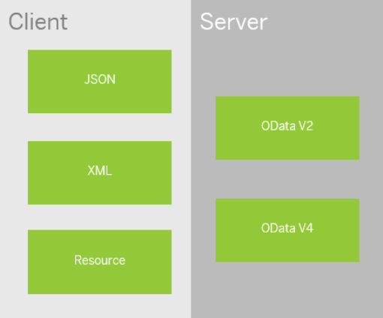
Model Basics
All the models in SAP UI5 are characterized in two different parts:
Client-Side Model: -
A model which keeps all the data in the browser. We use client-side model for manipulating data (like internal table).
Server-Side Model: -
Keeps data on server side, and ON-demand, it is loaded by client using the server-side model.
We can use the APIs (Methods) provided by SAP to access data from model
We need to get model object using methods
getModel(modelName)
setModel(modelName)
From model object we get access to the data using methods
setProperty(sPath, sValue)
getProperty(sPath)

Slide 16
Steps to Create a Model
3 Easy Steps to Create a Model
Step 1: Create a brand-new object of the Model
To Create JSON Model - var oModel = sap.ui.model.json.JOSNModel()
To create XML model – var oModel = sap.ui.model.xml.XMLModel()
To create Resource model – var oModel = sap.ui.model.resource.ResourceModel()
To create OData Model – var oModel = sap.ui.model.odata.v2.ODataModel()
Step 2: Set or Load the data in the Model
oModel.setData({});
oModel.loadData(filePath);
Step 3: Make the model aware to the application/view
sap.ui.getCore().setModel(oModel);
this.getView().setModel(oModel);
Create object of the Model
Set/Load Data in Model
Set Model at View Level

Slide 17
How to Address Model Properties?
In the json data we can make address as “Every curly braces is converted to / and every array item is converted to /index”.
{
"empStr": {
"empId": 0001,
"empName": "Anubhav",
"salary": 8000,
"currency": "USD"
},
"empTab": [{
"empId": 0009,
"empName": “Ananya",
"salary": 9500,
"currency": "USD“
}, {
"empId": 0010,
"empName": “Shwetha",
"salary": 10000,
"currency": “EUR"
}]
}
Q: what is the salary of Anubhav
/empStr/salary
Q. What is the emp name of emp 0001
/empStr/empName
Q. What is the salary of Shwetha
/empTab/1/salary
Q. What is the empId of Ananya
/empTab/0/empId

Slide 18

Exercise: Models and Model Binding
Model Exercise 1: Model Creation code within controller
In this exercise we will create a JSON model using a JavaScript Object.
After Creating the model, we will bind the model to the XML view in a Simple Form
Exercise code/resource:
MyView.controller.js
MyView.view.xml
Model Exercise 2: Model Creation code in models.js file.
In this exercise we will create a model.js file, In that file we will write code to create the model dynamically.
After that we will create two model and bind them with the form and on click of a button the model will be flipped.
Exercise code/resource:
MyView.controller.js
MyView.view.xml
models.js
mydata.json
mydata2.json

Slide 19

Concept of Binding in SAP UI5
Data binding is the process that establishes a connection between the application UI and business logic.
It is a bridge between a binding target and a binding source.
Sap ui5 provides three binding options
Property Binding
Expression Binding
Aggregation Binding
Element Binding
Property Binding:- When we bind property of a UI control, to the address of the model, this is called property binding. E.g., value property of Input control was connected to /emp/empId
Ex:-
In XML view:- <Text text=“{/emp/empId}” ></Text>
In controller: - this.getView().byId(“controlId”).bindProperty(“text”, ‘/emp/empId’);

Slide 20
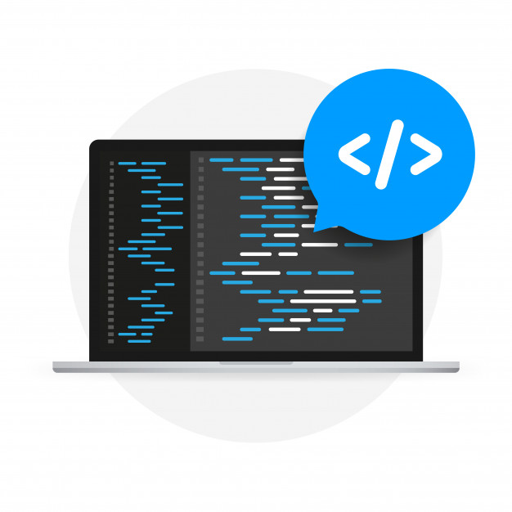
Expression Binding
Expression binding : - When we bind an Expression ({= condition ? true : false}) with the property of a control rather binding value to a property, this is called expression binding.
If we need some calculation on model data or some sort of comparison, then expression binding is useful.
Syntax:
numberState = “{= ${path} > value ? ‘conditionForTrue’ : ‘ConditionForFalse’ }”
Use Case of Expression Binding
My Manager want to make salary field grayed out (read-only) when employee is anubhav
If The Employee Name is Anubhav, Gray out Salary field.
Condition – if employee name = Anubhav
Outcome – make field gray out
Target – Salary field
Note: To use expression binding in our application we need to add line in the bootstrap code of UI5 in index.html
data-sap-ui-bindingSyntax="complex"

Slide 21

Exercise: Expression Binding
In this exercise we will see the example of both property binding and expression binding.
In this file we also see that how to get data form the file in the model.
Exercise code:-
MyXML.controller.js
MyXML.view.xml
index.html

Slide 22
Binding Modes
There are basically three modes of binding data in SAPUI5.
One-way binding – Here, the data is transported in one direction only, i.e., from the model, through the binding instance to the consumer (usually the property of a control), but never in the other direction. Any change done on the model data from the front end is not affected to the model. All the data changes are reflected only on the controls.
Two-way binding – Here all input changes done from front end controls are reflected on the model and the backend database. SAPUI5 automatically handles the transport of data both from the model to the controls and back from the controls to the model.
One-time binding – Here all data will be bound from model to view just once. After that, the connection is no more set.
Data
Data
Model
View
Model
View
Data
One-way binding
Two-way binding
Data
Data
Data
Model
View
Model
View
One-Time binding

Slide 23
Aggregation Binding
When we bind the aggregation of a control with the entityset of data model, it is called aggregation Binding.
The parent control (e.g. Table) is bound to the EntitySet path which is called absolute path and the child of the parent Control (e.g. Columns) are connected to the child properties of the EntitySet is called relative path.
In aggregation binding, based on your model data, as many child controls will be created automatically.
Every Event of UI5 will trigger the eventHandler and we will get the Event Object as part of the event Handler. Depending on the event, the event handler object will have different parameters.
Use Case of Aggregation Binding
If we want to show a list or some data in tabular format, we need to bind a group of data. In such a case we will use aggregation binding.
Absolute path
{
“empTab”: [
{
“empId”: 50,
“empName”: “Jay”,
“salary”: 9500
}
]
}
Table = {/empTab}
Emp Id | Emp Name | Salary
{empId} | {empName} | {salary}
Relative Paths

Slide 24

Exercise: Table in UI5 & Aggregation Binding
In this exercise we will create a table and load the data of some employees in it.
We will see how to use different controls in a table to represent data.
Exercise code/resource:-
MyView.view.xml
MyView.controller.js
mydata.json

Slide 25

Exercise - Dynamic Aggregation Binding
In this Exercise we will bind the rows property is the table dynamically form the column.
Exercise code/resources:
MyView.view.xml
MyView.controller.js

Slide 26
Element Binding
Element binding is useful for containers and layouts containing other controls. All these child controls would be required to use properties of the same model object or model node, then element-binding is preferable.
An element to be bound to an object in the Model can be achieved by Element binding.
Use case:- On Select of a row in the table show the row data in a form.
Table
/empTab/0
/empTab/1
/empTab/2
Emp Id | Emp Name | Salary
{empId} | {empName} | {salary}
Element 0
Element 1
Element 2
Simple Form
Field 0
/empId
All the content of Row 1 in the table is bind to all the fields in the form
Field 1
/empName
Field 2
/salary

Slide 27

Exercise: Element Binding
In this exercise we will use element binding to bind the data of a selected row with the form.
Exercise code/resources:-
MyView.view.xml
MyView.controller.js

Slide 28

End of Day 6

Slide 29

Questions

Slide 30

Anubhav Oberoy

Slide 31


We’re committed to empower you to be
Most Desirable Resource
through powerful training solutions.
We build the workforce of the future.
250+
Corporate Clients
30,000+
Learners Trained
25000+
Learners Placed
FREE WEBINARS
Sign up for free webinars with industry experts every fortnight!
Enroll Now!
Contact us today!
https://anubhavtrainings.com/

Slide 32




More from AnubhavTrainings.com

Slide 33
Title
Content

